Slide 1
A study on the modelling of the distribution automation systems using Petri Nets
Student：Huiyuan Xiao
Professor: Prof. Antonello Monti
Supervisor : Abhinav Sadu
Huiyuan Xiao

Slide 2
One sentence introduction
The objective of present thesis is to
employ different types of Petri Nets (SCPN,STPN)
with different tools (PIPE, ORIS)
in different levels (function layer, component layer)
for qualitative (survivability, dependability)
and quantitative (reliability, availability) analysis
of distribution automation systems (IDE4L)

Slide 3
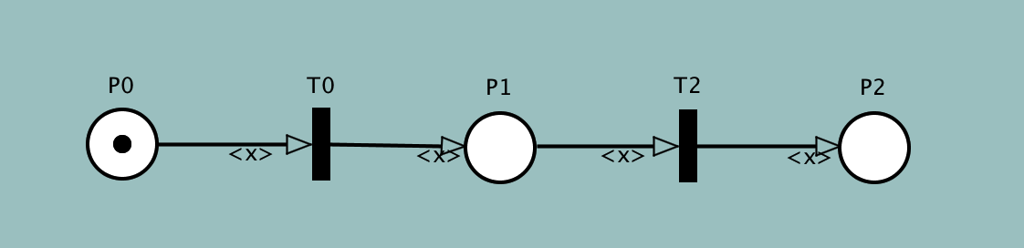
Petri Nets Basis
Petri net is a visual graphical mathematical modelling language to model static structure and dynamic change of Discrete Event Dynamic System (DEDS)
It is a structured description tool which is able to represent synchrony, synchronisation, and parallel logical relationships.
Place : a circle (P0,P1,92)
Transition: a rectangle (T0,T2)
Arc: a tangential arc between the place and the transition
Token: a dynamic object in the place (represented by a dot in the place P) that can be moved from one place to another

Slide 4
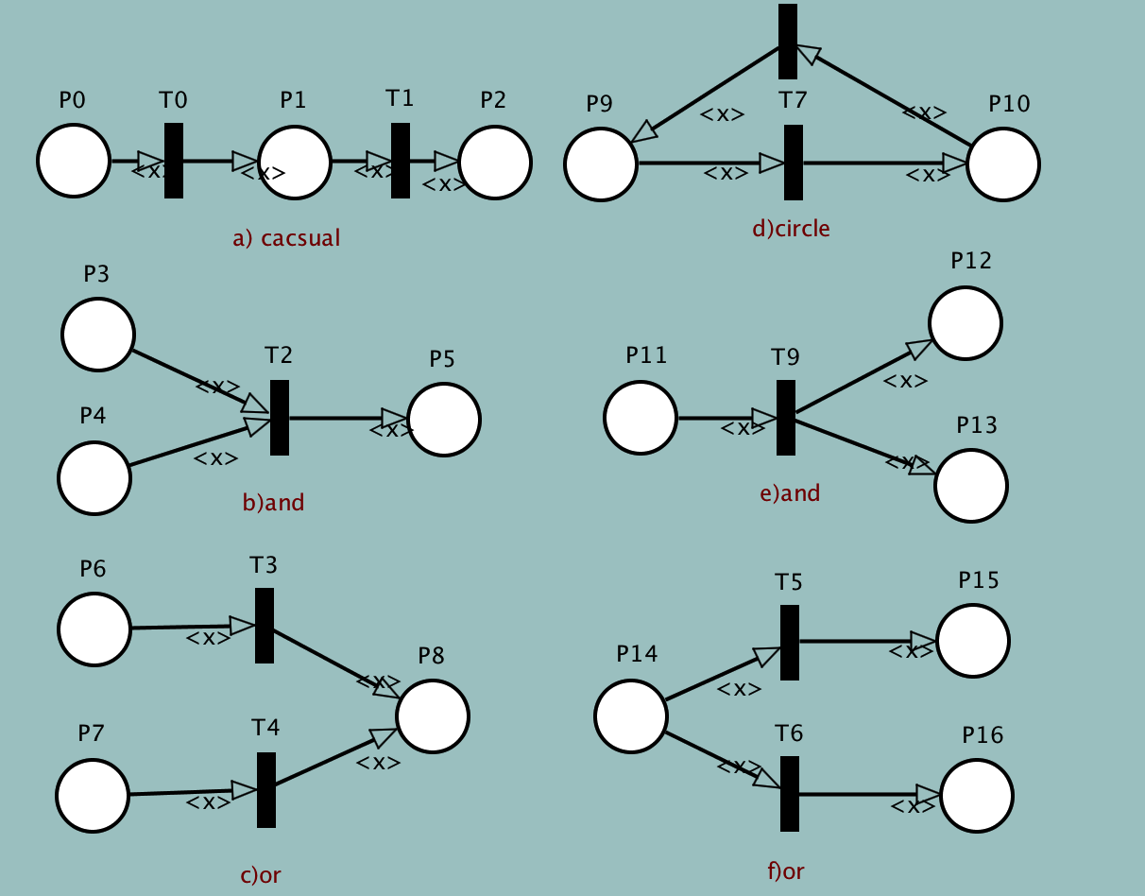
Petri Nets Properties and logic
Properties
Reachability
Boundness and safety
Liveness
Reversibility and home state
Basic logic connections
Basic logic connections represented by Petri Net

Slide 5
Petri Nets Types and characteristics
Petri net extensions
Stochastic Colour Petri Net (SCPN)
can define and identify different tokens in the same place, thus completing a more complex logical network architecture
Stochastic Timed Petri Net (STPN)
transition may have time delay

Slide 6
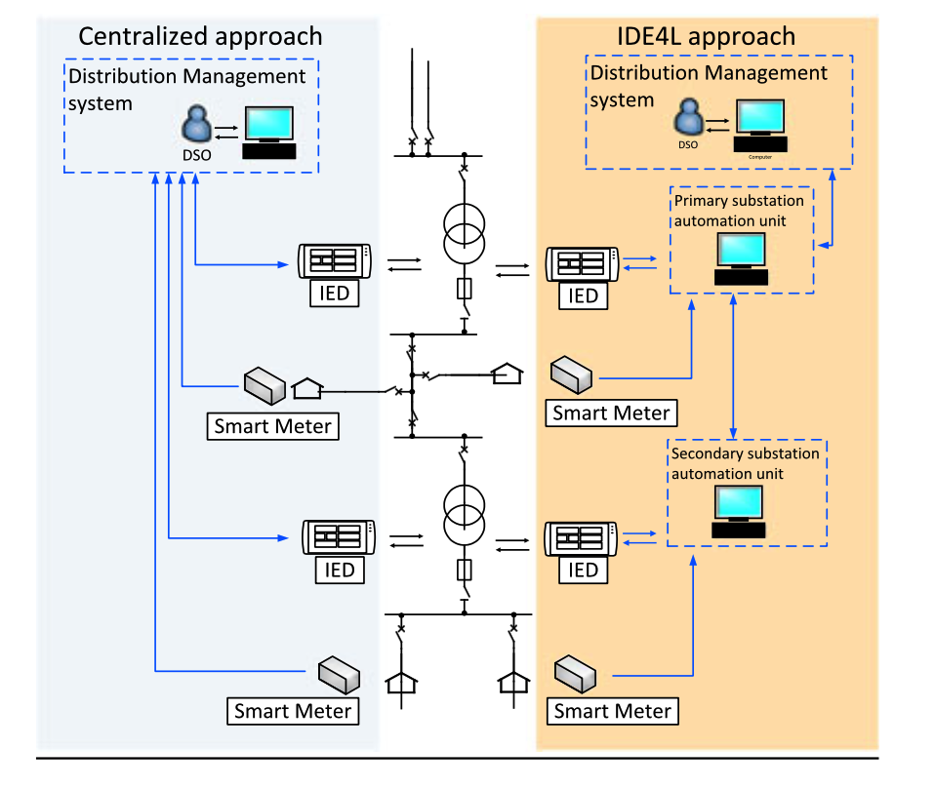
IDE4L project Automation concept and architecture
The IDE4L (Ideal Grid for All) project is funded by the 7th Framework Programm of the European Commission from September 2013 to August 2016, with a budget of €8M.
The aim of the project is to define,design and demonstrate “ideal grid for all”, an active distribution network which integrates Renewable Energy Sources (RESs) and new loads, and guarantees the reliability of classical distribution networks.
The automation architecture development of IDE4L is supported by two main concepts:
Use Case (UC) Methodology
Smart Grid Architecture Model (SGAM) framework
Characteristics:
Hierarchical and decentralised automation architecture
Modular distributed processing;
Reusable procedures.
Comparison between centralized and IDE4L approach.

Slide 7
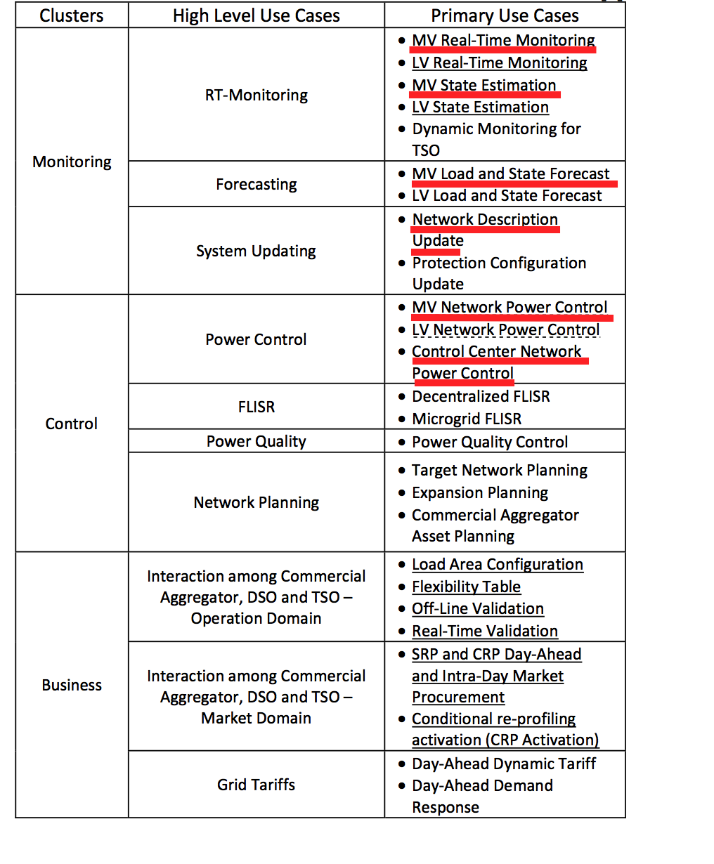
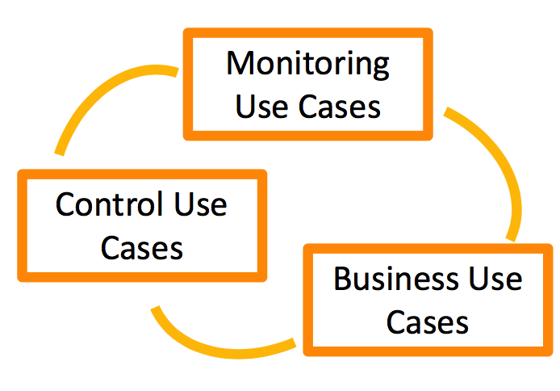
IDE4L project Use case (UC) Methodology
We will focus on 6 major monitoring and control use cases in MV level in following analysis

Slide 8
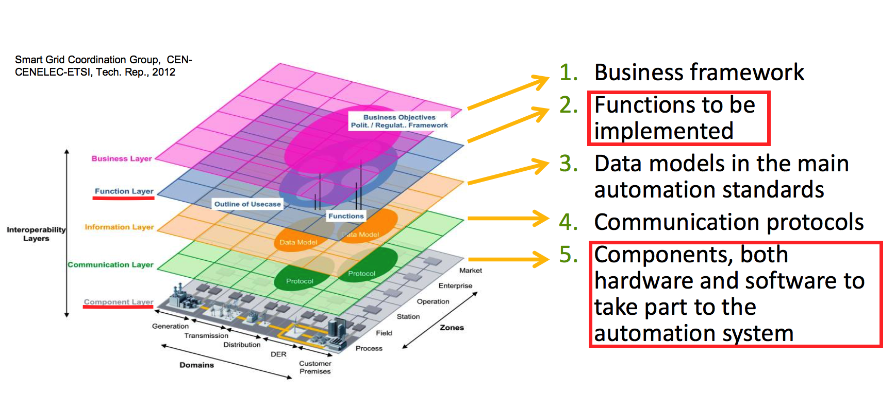
IDE4L project SGAM architecture
General description and link to use cases :
Function layer：Survivability analysis
Component layer：Dependability analysis

Slide 9
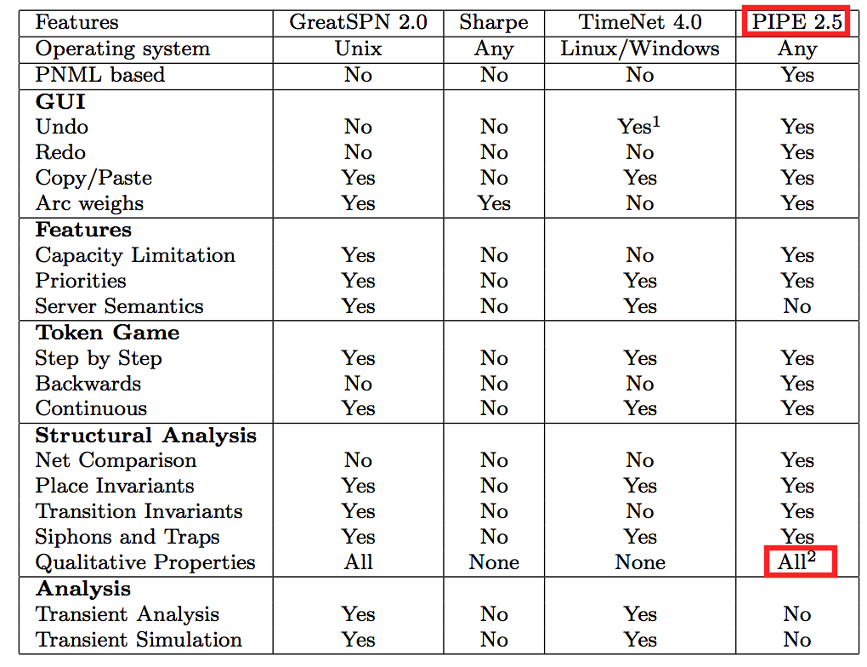
Petri Nets Tools
The different focusing layers of IDE4L project and different analysis needs of use cases should be combined with the corresponding tool characteristics and personal preferences to complete the tool selection.
We choose PIPE as the main tool.

Slide 10
Qualitative analysis
Survivability is the ability of the target system to recover predefined operation state in a timely manner after the occurrence of disasters.
So we evaluate the impact of physical components (actors) failure on overall system through simulation for Survivability Analysis.
Dependability is the capability of the target system to avoid service failures which may cause great losses more than is acceptable.
So we abstract the main failure modes from complex application scenarios then model the failure chain using STPN for Dependability Analysis.

Slide 11
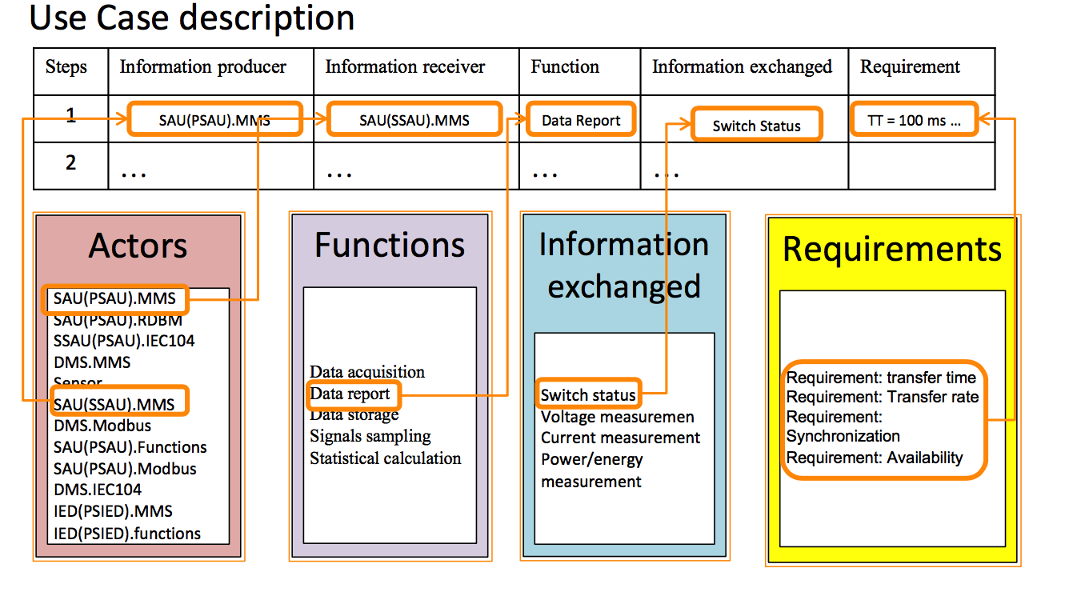
Qualitative analysis Survivability
actors —— places
functions —— transitions
information flow——directional arc
different information or data sources —— different colour tokens

Slide 12
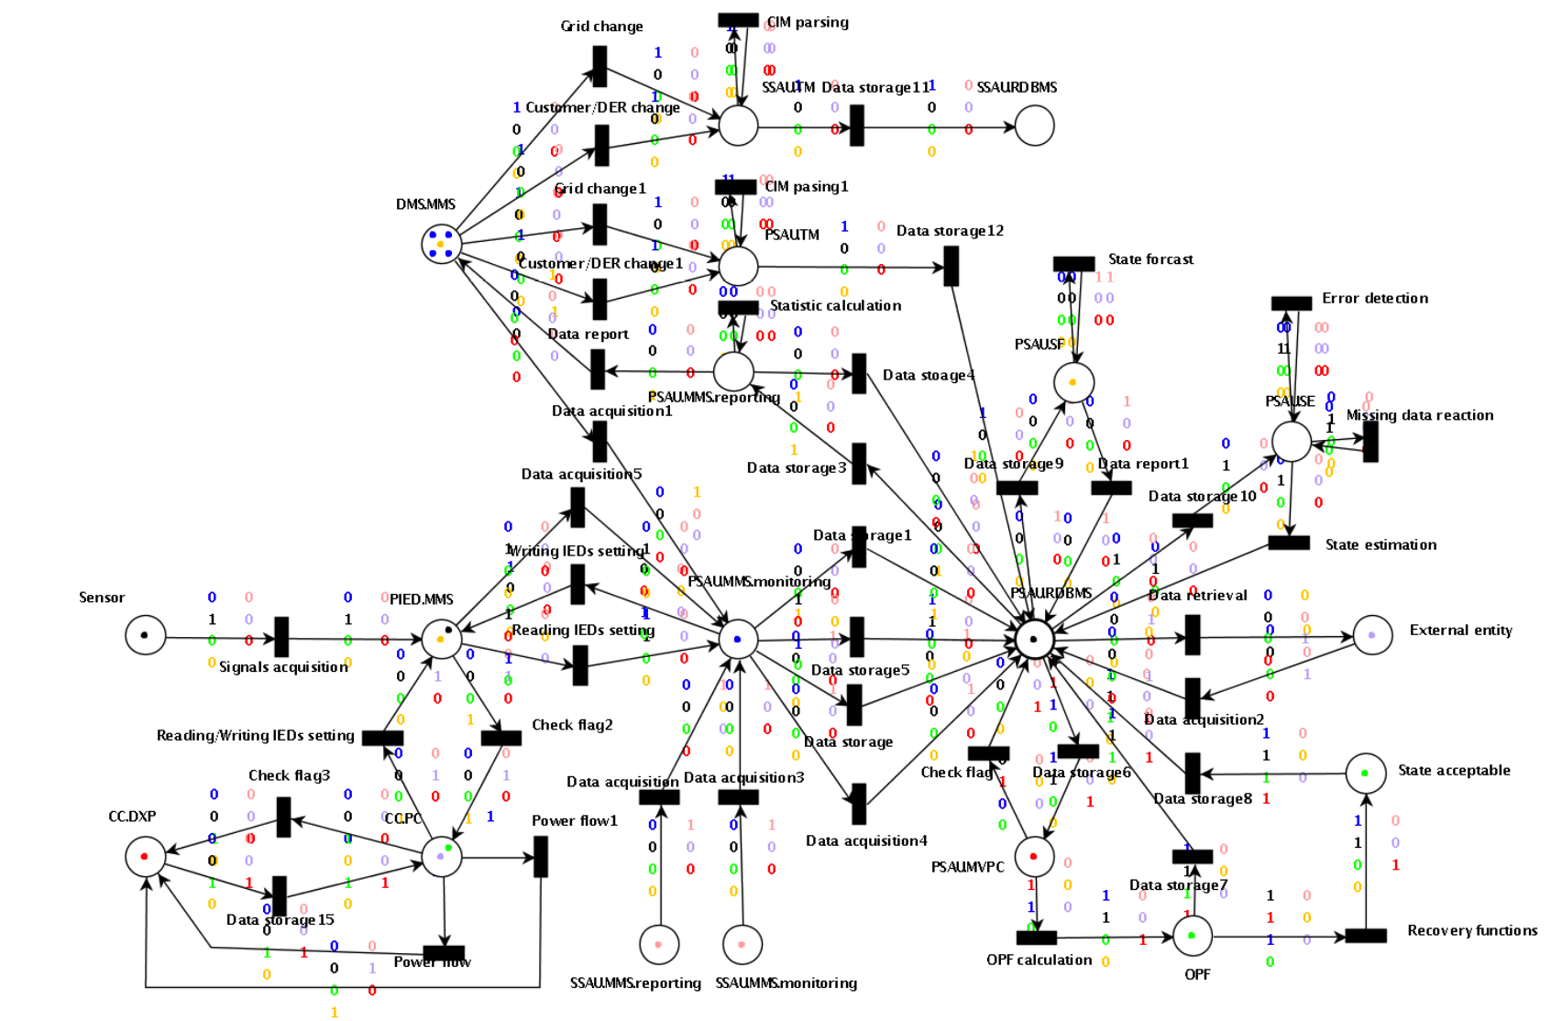
Qualitative analysis Survivability
MVPC,MVRTM,MVSE,MVSF,NDU,CCPC

Slide 13
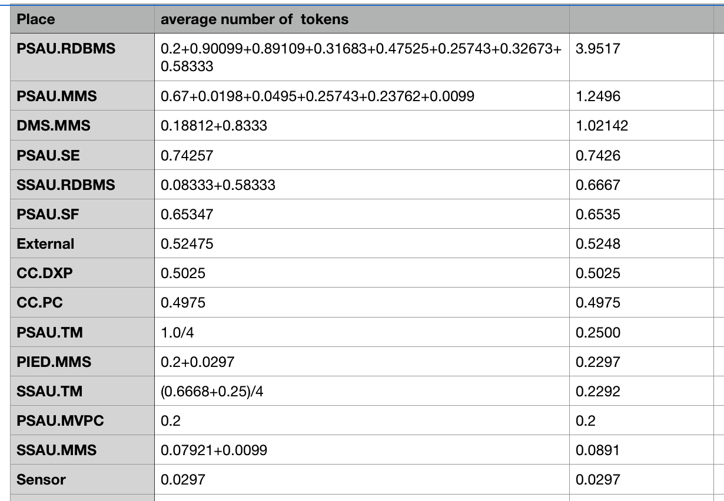
Qualitative analysis Survivability
In component level PSAU is the most important component
In function level PSAU.RDBMS has the greatest impact for survivability

Slide 14
Theoretical basis behind results
Centralized architecture (CA) :
Coordination take place at the control center level, the so-called distribution management system (DMS)
Centralized data risk, time consuming execution
Fully distributed automation:
Lacks in effective coordination among the different actors
IDE4L automation distribution architecture：
Allocating the intelligence at each voltage level, PSAUs are responsible for the MV network and SSAUs address the need related to LV network
Reducing the DMS computational and communication burden, while maintaining the possibility to coordinate the automation in a hierarchical way
A proper coordination among the SAUs and with the DMS guarantees effective monitoring and control functionalities within shorter time frames than CA approaches and with higher efficiency than the fully distributed architectures.

Slide 15
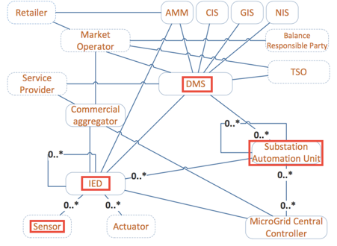
Qualitative analysis Dependability
For simplicity, in this section, we first assume one substation network equipped with only one Sensor, one IED, one PSAU, and one DMS server to demonstrate the dependability evaluation procedures.

Slide 16
Qualitative analysis Dependability
For simplicity, in this section, we first assume one substation network equipped with only one Sensor, one IED, one PSAU, and one DMS server to demonstrate the dependability evaluation procedures.

Slide 17


Quantitative analysis Reliability
Reliability is used to evaluate the capability to continuously provide services without failures.
In detail, it can be defined as the probability that the control center networks work correctly during the period[0,t].
where X is the continuous random variable of correct operation time for control center networks:
Transient :
Steady-state:

Slide 18

Quantitative analysis Avalability
Avalability describes the readiness of correct services for
some critical components:
Transient :
Steady-state:

Slide 19
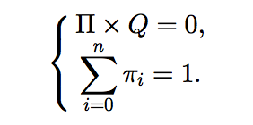

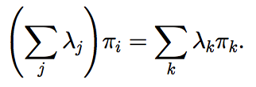

Quantitative analysis Calculation method of reliability and availability
Calculation method of reliability and availability from both steady-state and transient aspects involves two steps:
the analysis of the equivalent continuous time Markov chain
and the computation of reliability and availability.
There are two equivalent methods to compute the steady- state probability of CTMC.

Slide 20
Thanks for your attention!
Any question?
Contact
E.ON Energy Research Center
Mathieustraße 10
52074 Aachen
Germany
Huiyuan Xiao
T +49 17681596277
Huiyuan.Xiao@eonerc.rwth-aachen.de

